Slide 1

Introduction to Robotics
2016 Fall

Slide 2
Project Roadmap
Date | Project | Finished?
9/06/16 | Introduction of Robot and Robotics, mBot Assembly | yes
9/13/16 | Introduction of mBlock | yes
9/20/16 | Play an Octave | yes
9/27/16 | Push a Button | yes
10/04/16 | Light Sensor, UltraSonic Sensor
10/11/16 | Drive with Remote, Line Following
10/18/16 | Robot Movement 1
10/25/16 | Robot Movement 2, Trace a Shape
11/01/16 | Obstacle Avoidance
11/08/16 | Sumo Wrestling 1
11/15/16 | Sumo Wrestling 1
11/22/16 | Maze 1
11/29/16 | Maze 2
12/06/16 | C Programming 1
12/13/16 | C Programming 2

Slide 3
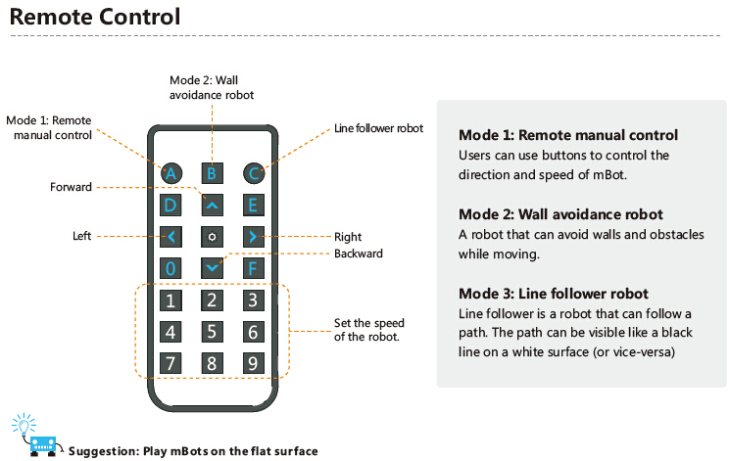
Project: Drive by Remote

Slide 4
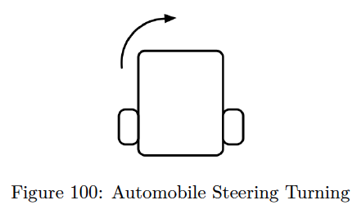
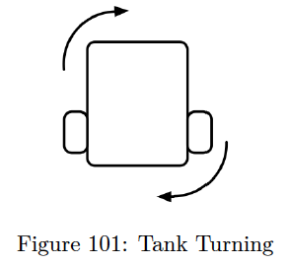
Project: Drive by Remote
1. The mBot shall move forward when the up arrow on the remote is pressed.
2. The mBot shall move backward when the down arrow on the remote is pressed.
3. The mBot shall turn left when the left arrow on the remote is pressed.
4. The mBot shall turn right when the right arrow on the remote is pressed.
5. The mBot shall stop when none of the arrow buttons are pressed.
6. The mBot shall not respond to any button presses that are not listed above.

Slide 5
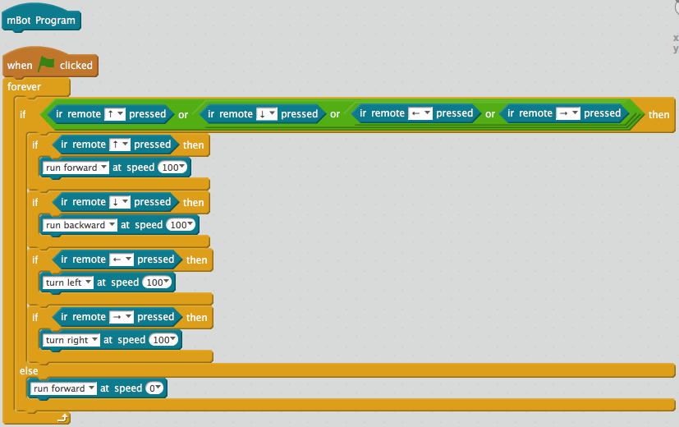
Project: Drive by Remote

Slide 6
Challenges: Drive by Remote
Modify the program to do the following:
1. Set up additional buttons to increase and decrease the speed of the robot.
2. Set up an additional button to make a sound on the buzzer based on some action, such as a beeper when the robot is backing up.

Slide 7
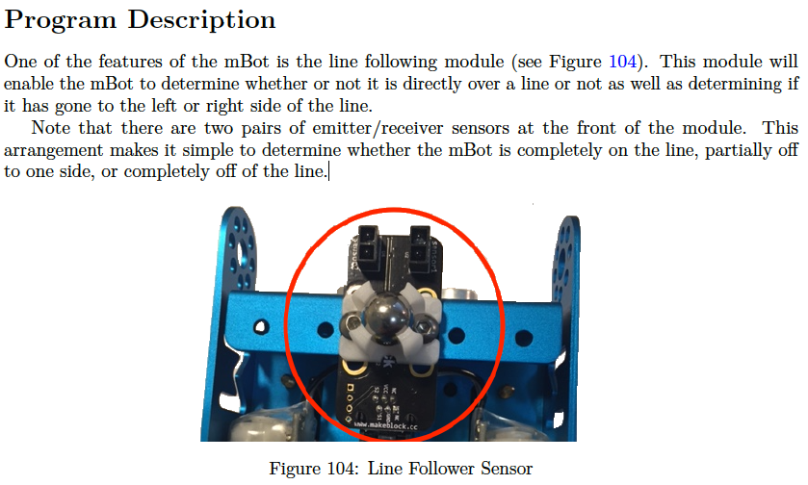
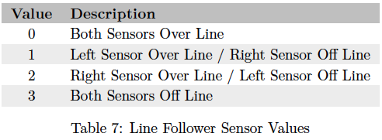
Project: Line Follower

Slide 8
Project: Line Follower
Requirements
1. The mBot shall detect a path marked by a dark line.
2. The mBot shall move forward along the path.
3. The mBot shall turn as needed to stay on the path.
4. The mBot shall execute a strategy to find the path if it strays off of the path.

Slide 9
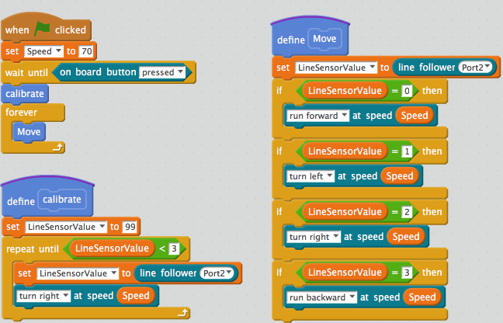
Project: Line Follower

Slide 10
Line Follower: Challenges
Modify the program to do the following:
1. Make noise when turning left/right.
2. Use colors on the LEDs to indicate which part of the program is being executed.
3. Develop an alternate strategy for if the mBot cannot find the line.
4. Develop a strategy for when the line is not within initial turn radius.

